Slide 1
Learning Objective
I will be able to utilise the second derivatives to sketch functions
Success Criteria
At the end of the lesson, I will be able to:
Examine the concepts of concavity and points of inflection and their relationship with the second derivative
Apply the second derivative test for determining local maxima and minima
Sketch the graph of a function using first and second derivatives to locate stationary points and points of inflection

Slide 2
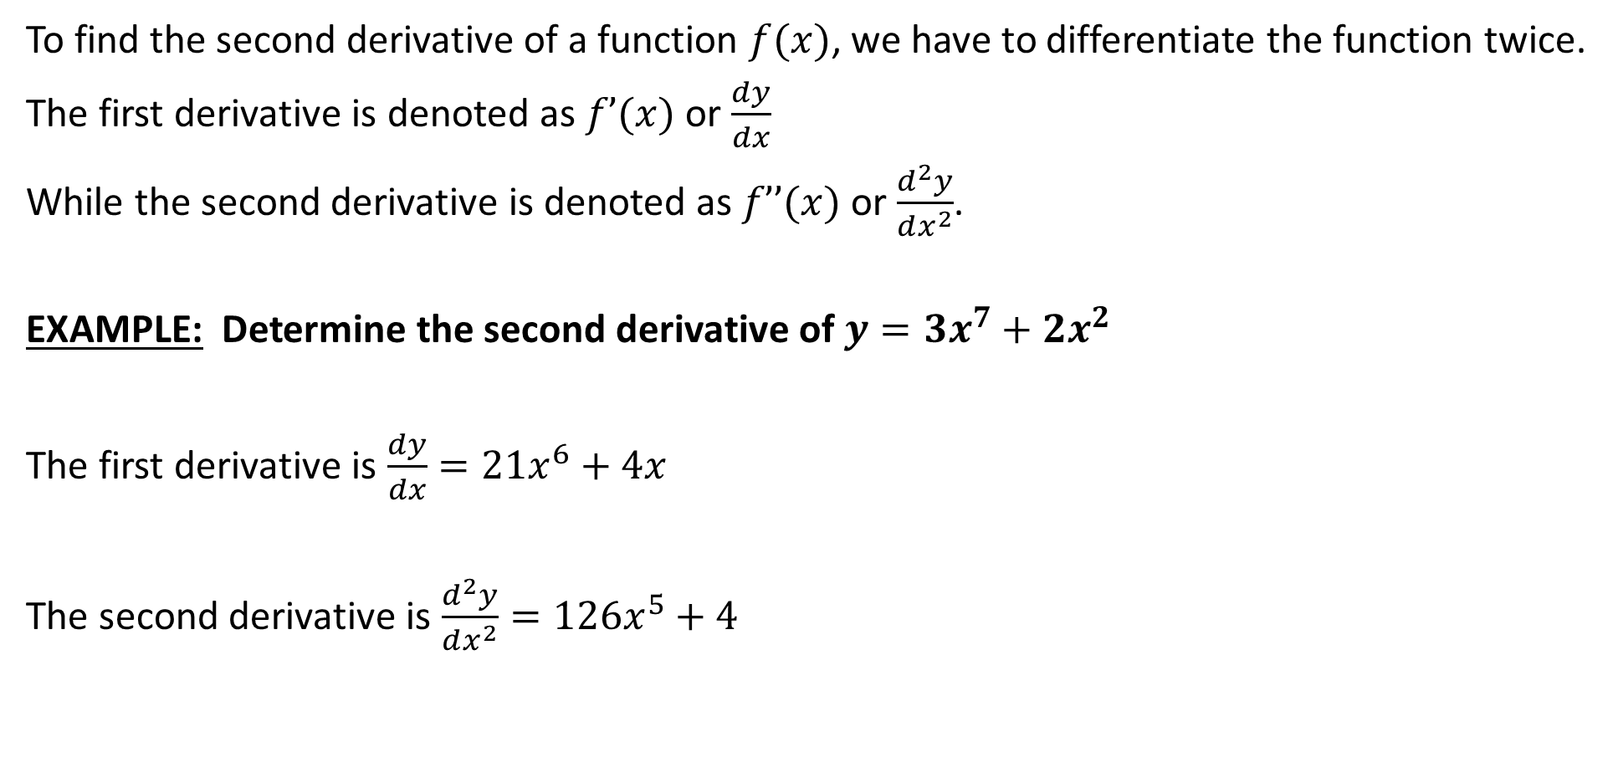
Activating Prior Knowledge
To find the second derivative of a function $f(x)$, we have to differentiate the function twice.
The first derivative is denoted as $f’(x)$ or $\frac{dy}{dx}$
While the second derivative is denoted as $f’’(x)$ or $\frac{d^{2}y}{dx^{2}}$.
EXAMPLE: Determine the second derivative of $y=3x^{7}+2x^{2}$
The first derivative is $\frac{dy}{dx}=21x^{6}+4x$
The second derivative is $\frac{d^{2}y}{dx^{2}}=126x^{5}+4$

Slide 3
The Second Derivative
Each time we differentiate a function, we obtain information about our original function.
The first derivative tells us:
the rate of change of a function at a point
helps us to determine the locations of all stationary points of a function.
The second derivative helps us to determine:
Stationary points as horizontal points of inflection or maximum/minimum turning points
Concavity and behaviour of the function
Other points of inflection

Slide 4
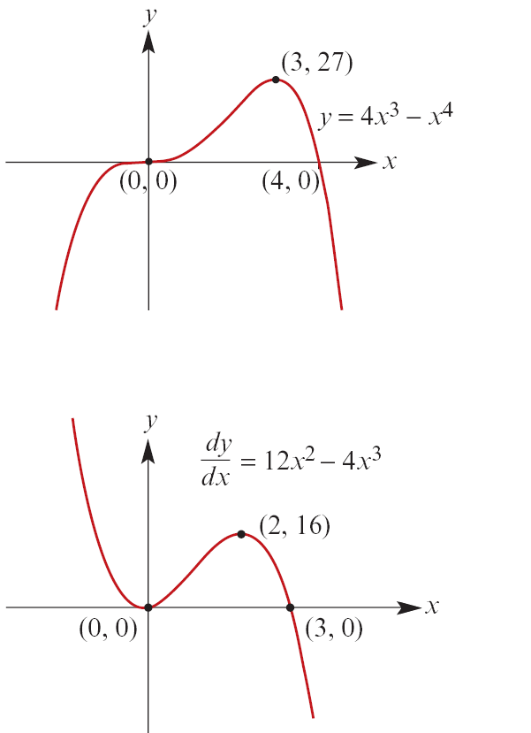
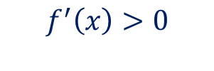

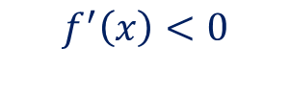
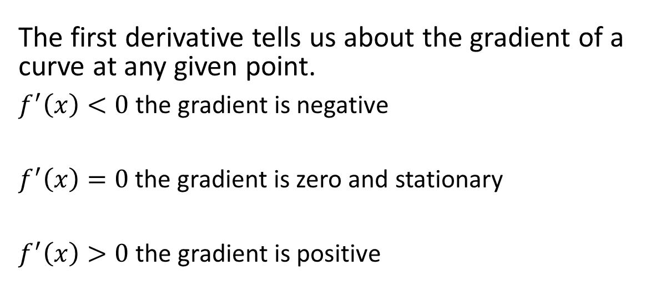


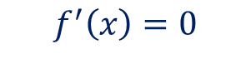
Activating Prior Knowledge
The first derivative tells us about the gradient of a curve at any given point.
$f^{′}\left(x\right)<0$ the gradient is negative
$f^{′}\left(x\right)=0$ the gradient is zero and stationary
$f^{′}\left(x\right)>0$ the gradient is positive
$$f^{′}\left(x\right)>0$$
$$f^{′}\left(x\right)<0$$
$$f^{′}\left(x\right)=0$$

Slide 5
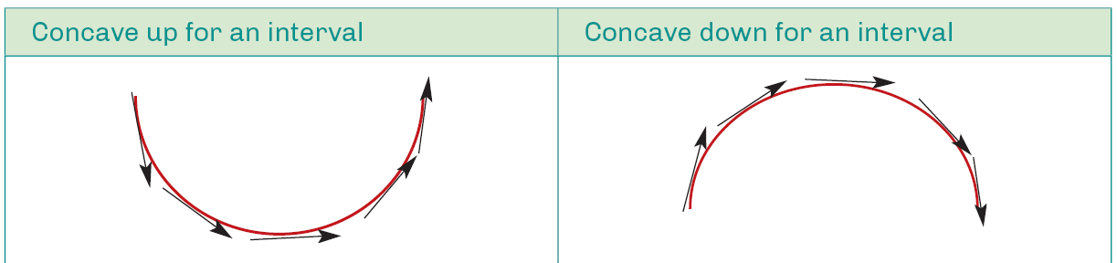
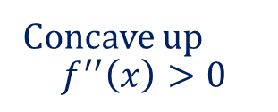
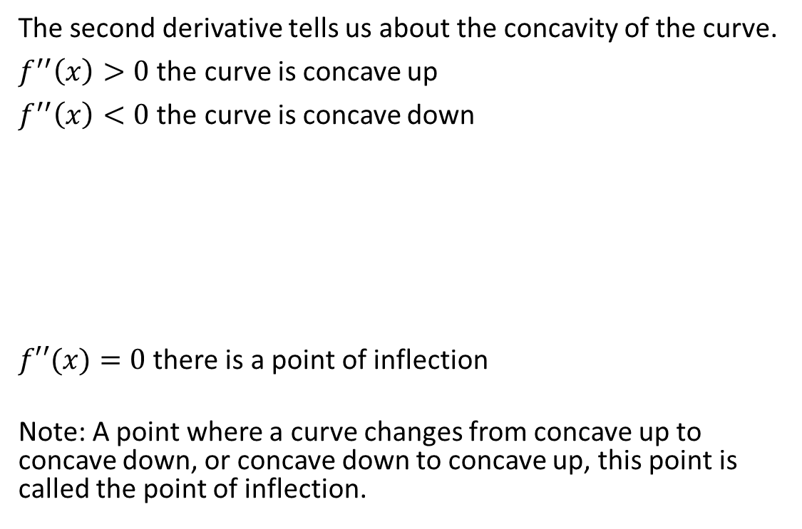

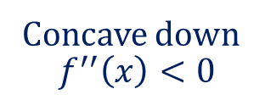

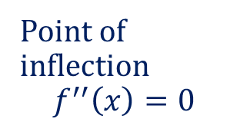

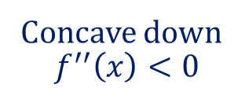

Testing Concavity using the Second Derivative
The second derivative tells us about the concavity of the curve.
$f^{′′}\left(x\right)>0$ the curve is concave up
$f^{′′}\left(x\right)<0$ the curve is concave down
$f′′(x)=0$ there is a point of inflection
Note: A point where a curve changes from concave up to concave down, or concave down to concave up, this point is called the point of inflection.
Concave down
$$f^{′′}\left(x\right)<0$$
Concave down
$$f^{′′}\left(x\right)<0$$
Point of inflection
$$f^{′′}\left(x\right)=0$$
Concave up
$$f^{′′}\left(x\right)>0$$

Slide 6










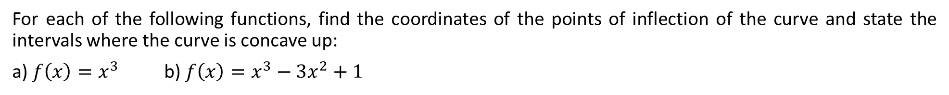




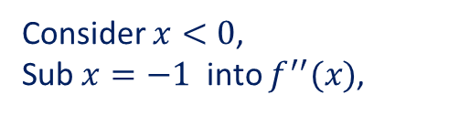













Guided Practice
For each of the following functions, find the coordinates of the points of inflection of the curve and state the intervals where the curve is concave up:
a) $f\left(x\right)=x^{3}$ b) $f\left(x\right)=x^{3}−3x^{2}+1$
b) $f^{′}\left(x\right)=3x^{2}−6x$
$$f^{′′}\left(x\right)=6x−6$$
a) $f^{′}\left(x\right)=3x^{2}$
To find point of inflection, sub $f^{′′}\left(x\right)=0$
$$f^{′′}\left(x\right)=6x$$
$$6x−6=0$$
To find point of inflection, sub $f^{′′}\left(x\right)=0$
$$x=1$$
$$6x=0$$
Sub $x=1$ into $f(x)$,
$$x=0$$
$$f\left(1\right)=−1$$
Sub $x=0$ into $f(x)$,
Point of inflection, $\left(1,−1\right)$
$$f\left(0\right)=0$$
Consider $x<1$,
Sub $x=0$ into $f^{′′}(x)$,
Point of inflection, $\left(0,0\right)$
Consider $x<0$,
Sub $x=−1$ into $f^{′′}(x)$,
$$f^{′′}\left(0\right)=−6<0$$
Curve is concave down for interval $(−∞,1)$
$$f^{′′}\left(−1\right)=−6<0$$
Consider $x>1$,
Sub $x=2$ into $f^{′′}(x)$,
Curve is concave down for interval $(−∞,0)$
Consider $x>0$,
Sub $x=1$ into $f^{′′}(x)$,
$$f^{′′}\left(2\right)=6>0$$
Curve is concave up for interval $(1, ∞)$
$$f^{′′}\left(1\right)=6>0$$
Curve is concave up for interval $(0, ∞)$

Slide 7
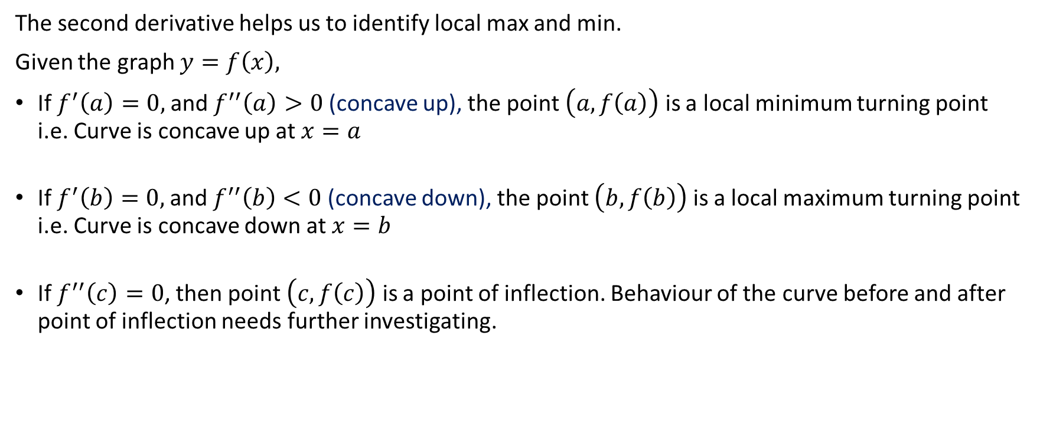
Testing local max or min using the Second Derivative
The second derivative helps us to identify local max and min.
Given the graph $y=f\left(x\right),$
If $f^{′}\left(a\right)=0,$and $f^{′′}\left(a\right)>0$(concave up), the point $\left(a, f\left(a\right)\right)$ is a local minimum turning point i.e. Curve is concave up at $x=a$
If $f^{′}\left(b\right)=0,$and $f^{′′}\left(b\right)<0$(concave down), the point $\left(b, f\left(b\right)\right)$ is a local maximum turning point i.e. Curve is concave down at $x=b$
If $f^{′′}\left(c\right)=0$, then point $\left(c, f\left(c\right)\right)$ is a point of inflection. Behaviour of the curve before and after point of inflection needs further investigating.

Slide 8
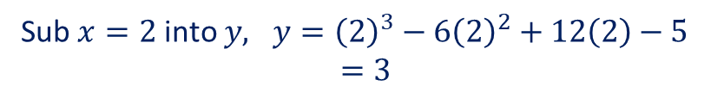







Guided Practice
Determine the location and nature of the stationary points of the following function. Are there points of inflection in the function?
$$y = x3 – 6x2 + 12x – 5$$
$$\frac{dy}{dx}=3x^{2}−12x+12$$
Sub $\frac{dy}{dx}=0, 3x^{2}−12x+12=0$
$$3\left(x^{2}−4x+4\right)=0$$
$$3{\left(x−2\right)}^{2}=0$$
$$x=2$$
Sub $x=2$ into $y, y={\left(2\right)}^{3}−6{\left(2\right)}^{2}+12\left(2\right)−5$ $$=3$$
$(2,3)$ is a stationary point
$$\frac{d^{2}y}{dx^{2}}=6x−12$$
Sub $x=2$ into $\frac{d^{2}y}{dx^{2}}, \frac{d^{2}y}{dx^{2}}=6\left(2\right)−12=0$
$∴(2,3)$ is a horizontal point of inflection.

Slide 9
Graphs of Derivatives
For the graph of a function f(x), when we draw the graph of the
derivative f’(x):
All stationary points in f(x) are roots in f’(x) where the gradient is equal to zero.
All points of inflection in f(x) become turning points in f’(x) because they determine the change in concavity
A horizontal point of inflection in f(x) is a turning point that just touches the x-axis
Where the graph of f(x) has NEGATIVE GRADIENT, the graph of f’(x) will be seen below the x-axis
Where the graph of f(x) has POSITIVE GRADIENT, we will see the graph of f’(x) above the x-axis.

Slide 10
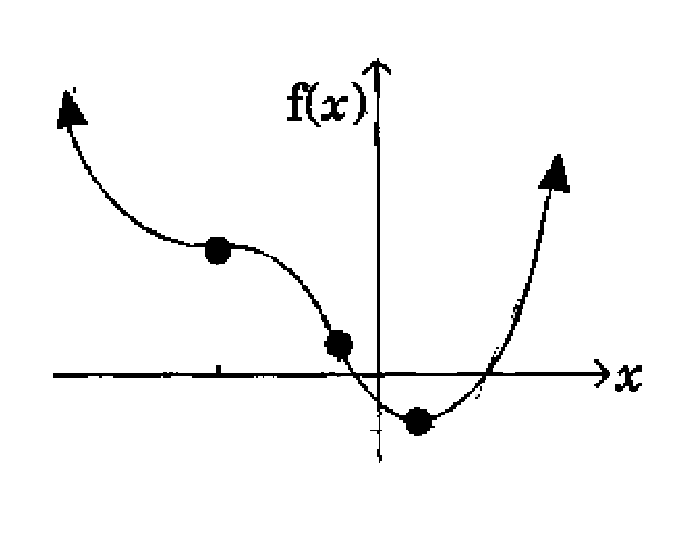
Guided Practice
The function $f(x)$ is shown graphed below. Construct the graph of its derivative $f′(x)$

Slide 11
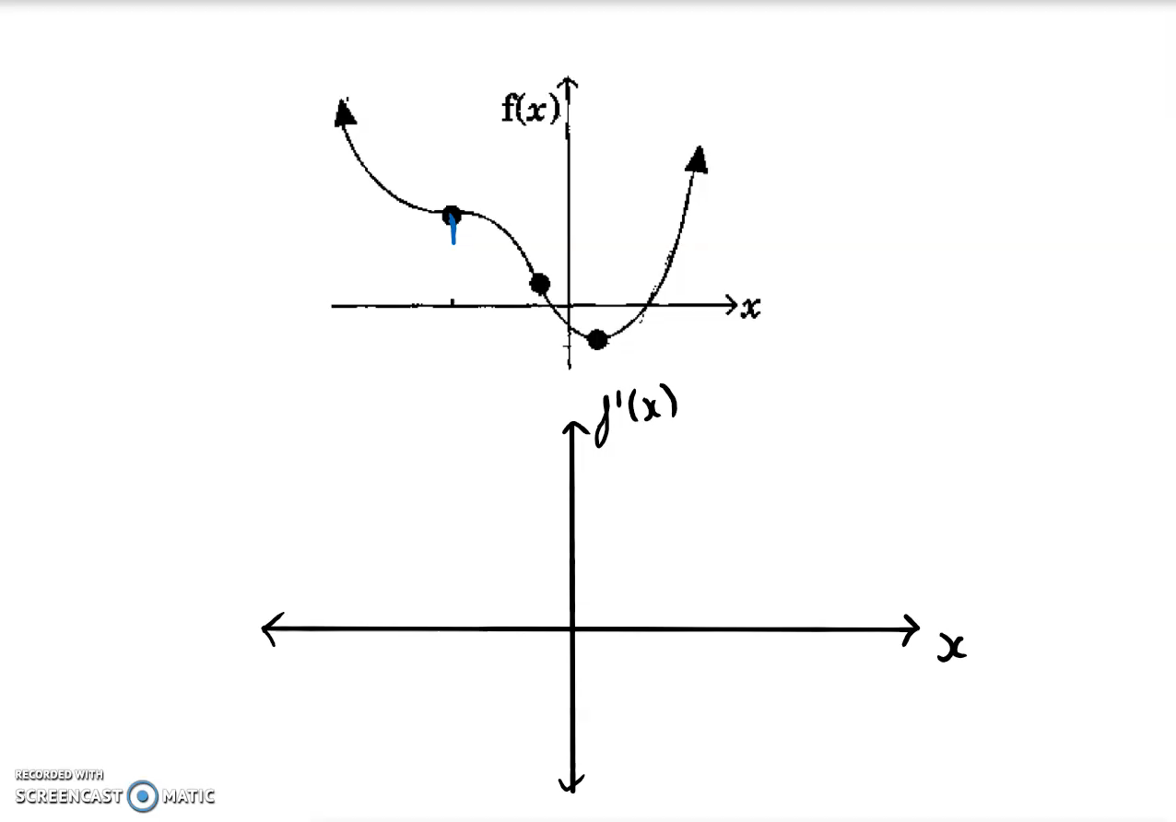
Guided Practice
To draw a graph of a derivative,
always note the locations of
stationary points and P.O.I.s
I use dotted lines to map them
out as shown.
In the graph of the derivative, y = f’(x) which means positive gradients appear in the positive region, negative gradients appear in the negative region and zero gradients should sit on the x-axis.
Stationary points should be sitting on the x-axis, because the gradient is equal to zero on this axis.
Identify where the gradients are negative, positive and zero.
Map them out carefully when constructing your derivative graph.
NEGATIVES go below the x-axis.
POSITIVE go above the x-axis.
ZEROES go on the x-axis.

Slide 12
Guided Practice
The final solution is shown on the left.
Use a pencil when you do derivative graphs – you can get deductions in your exams if your graph is unclear, especially if you have scribbled out your mistakes using pen…

Slide 13
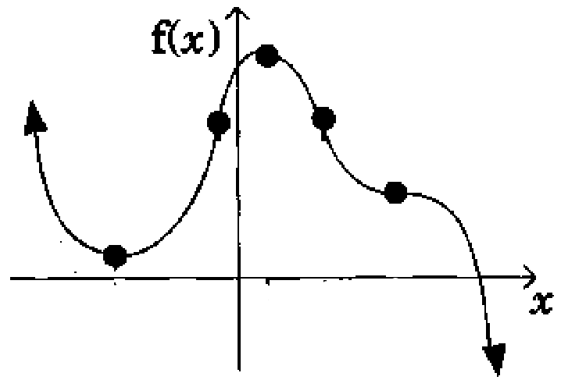
Guided Practice
The function $f(x)$ is shown graphed below. Construct the graph of its derivative $f′(x)$

Slide 14
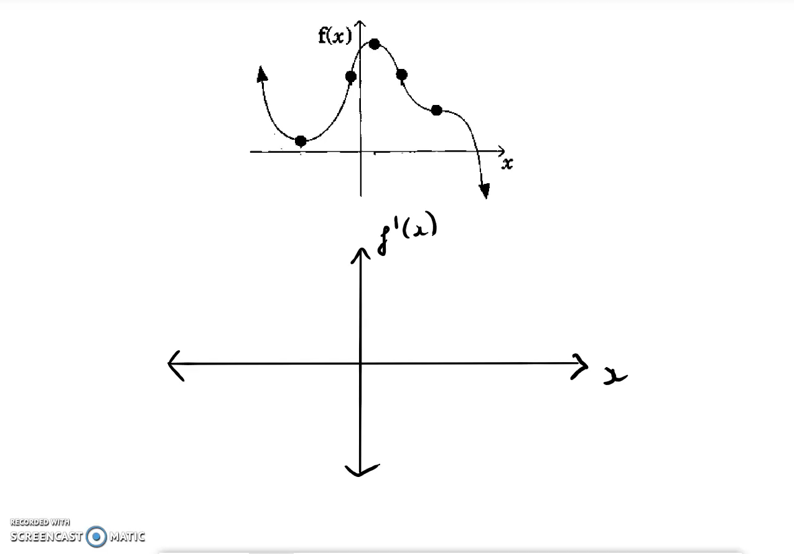
Guided Practice
Map the key points to the
derivative graph using dotted lines.
Locate the stationary points and
plot them on the derivative graph
Map the gradients of the original
function to the derivative graph.

Slide 15
Guided Practice

Slide 16

Guided Practice
The function $f(x)$ is shown graphed on the right. Construct the graph of its derivative $f′(x)$

Slide 17
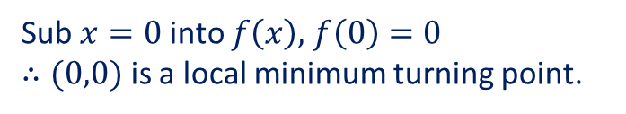
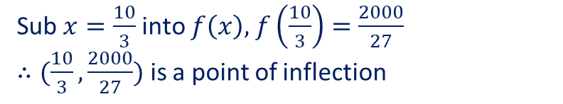




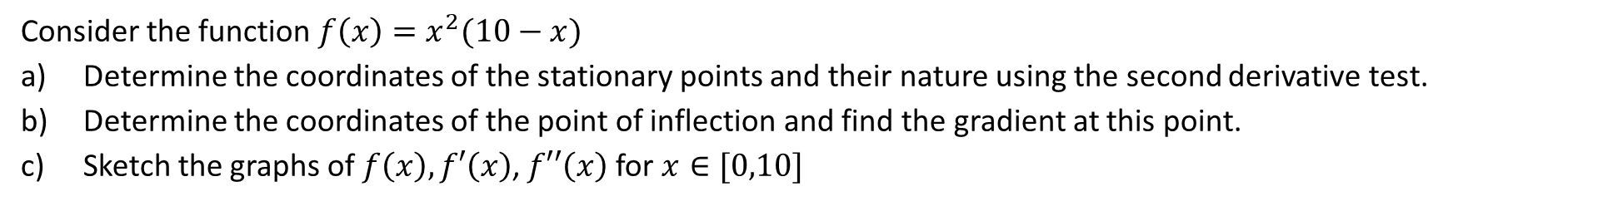




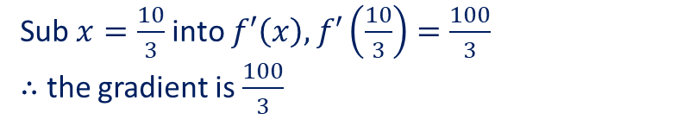

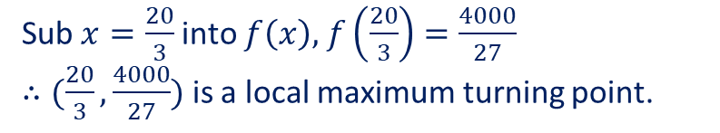
Guided Practice
Consider the function $f\left(x\right)=x^{2}(10−x)$
Determine the coordinates of the stationary points and their nature using the second derivative test.
Determine the coordinates of the point of inflection and find the gradient at this point.
Sketch the graphs of $f\left(x\right),f′\left(x\right)$, $f′′\left(x\right)$ for $x∈[0,10]$
$$f^{′}\left(x\right)=2x\left(10−x\right)+x^{2}(−1)$$
Sub $x=\frac{20}{3}$ into $f\left(x\right),$ $f\left(\frac{20}{3}\right)=\frac{4000}{27}$ $∴(\frac{20}{3},\frac{4000}{27})$ is a local maximum turning point.
$$=20x−2x^{2}−x^{2}$$
$$=20x−3x^{2}$$
$$f^{′′}\left(x\right)=20−6x$$
b) sub $f^{′′}\left(x\right)=0$
a) sub $f^{′}\left(x\right)=0$
$$20−6x=0$$
$$20x−3x^{2}=0$$
$$x=\frac{10}{3}$$
$$x(20−3x)=0$$
$$x=0, x=\frac{20}{3}$$
Sub $x=\frac{10}{3}$ into $f\left(x\right),$ $f\left(\frac{10}{3}\right)=\frac{2000}{27}$ $∴(\frac{10}{3},\frac{2000}{27})$ is a point of inflection
Sub $x=0$ into $f^{′′}\left(x\right),$ $f^{′′}\left(0\right)=20>0$
Sub $x=\frac{20}{3}$ into $f^{′′}\left(x\right),$ $f^{′′}\left(\frac{20}{3}\right)=−20<0$
Sub $x=\frac{10}{3}$ into $f′\left(x\right),$ $f′\left(\frac{10}{3}\right)=\frac{100}{3}$ $∴$ the gradient is $\frac{100}{3}$
Sub $x=0$ into $f\left(x\right),$ $f\left(0\right)=0$ $∴(0,0)$ is a local minimum turning point.

Slide 18




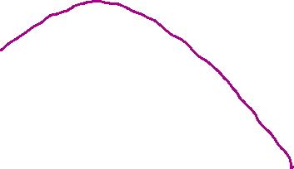


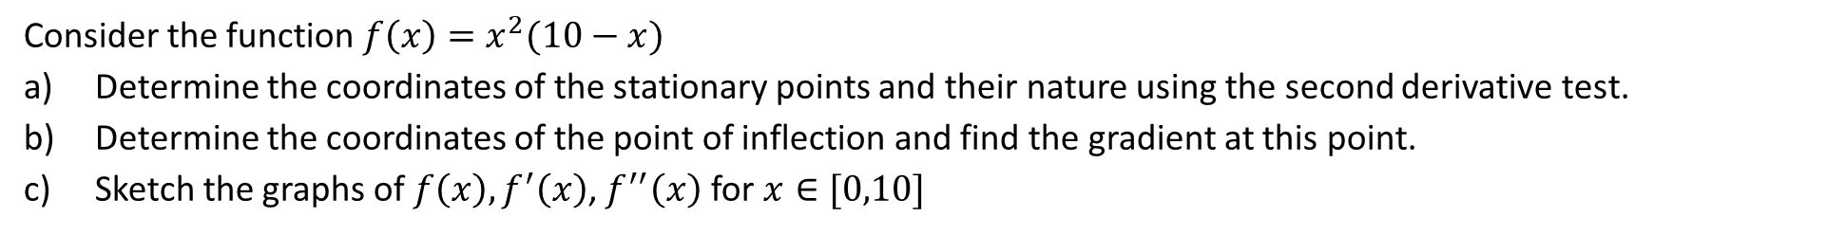




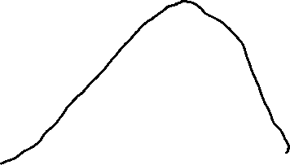

Guided Practice
Consider the function $f\left(x\right)=x^{2}(10−x)$
Determine the coordinates of the stationary points and their nature using the second derivative test.
Determine the coordinates of the point of inflection and find the gradient at this point.
Sketch the graphs of $f\left(x\right),f^{′}\left(x\right)$, $f^{′′}\left(x\right)$ for $x∈[0,10]$
$$f^{′}\left(x\right)=20x−3x^{2}$$
$$f^{′′}\left(x\right)=20−6x$$
Local minimum turning point $\left(0,0\right)⇒$ concave up
local maximum turning point $\left(\frac{20}{3},\frac{4000}{27}\right)⇒$ concave down
$(\frac{10}{3},\frac{2000}{27})$ is a point of inflection
Sub $x<\frac{10}{3}$ into $f^{′′}\left(x\right),$ $f^{′′}\left(2\right)=8>0$
$∴$ curve is concave up when $x<\frac{10}{3}$
Sub $x>\frac{10}{3}$ into $f^{′′}\left(x\right),$ $f^{′′}\left(4\right)=−4<0$
$∴$ curve is concave down when $x>\frac{10}{3}$

Slide 19
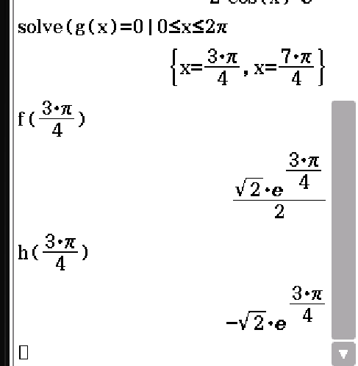
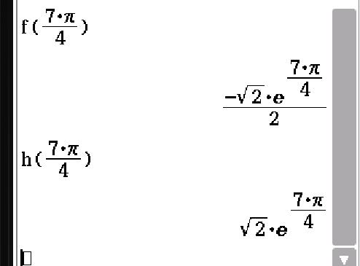
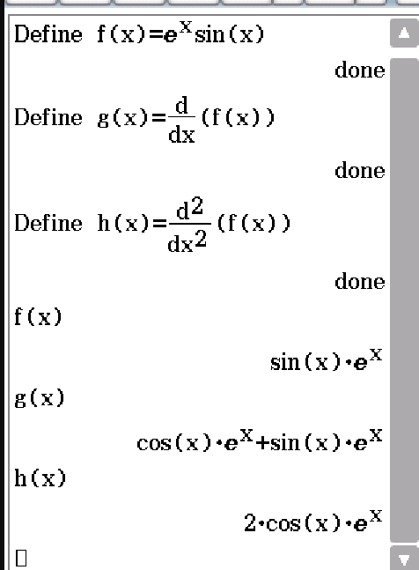
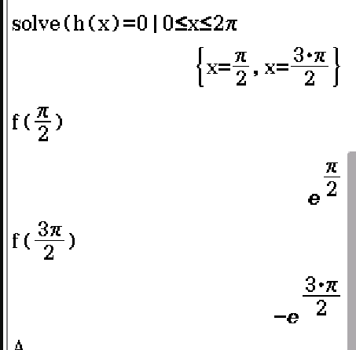
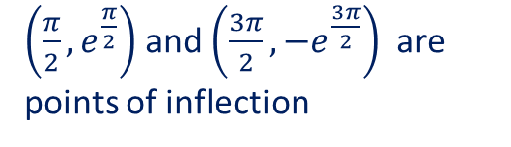
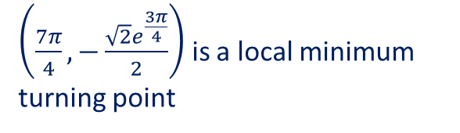
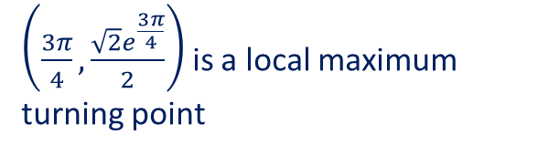
Guided Practice
Use a ClassPad to determine the stationary points, its nature and points of inflection of the graph $f\left(x\right)=e^{x}\sin{x}$for $x∈[0,2π]$
$\left(\frac{7π}{4},−\frac{\sqrt{2}e^{\frac{3π}{4}}}{2}\right)$ is a local minimum turning point
$\left(\frac{3π}{4},\frac{\sqrt{2}e^{\frac{3π}{4}}}{2}\right)$ is a local maximum turning point
$\left(\frac{π}{2},e^{\frac{π}{2}}\right)$ and $\left(\frac{3π}{2},−e^{\frac{3π}{2}}\right)$ are points of inflection

Slide 20




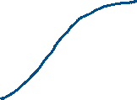











Guided Practice
Sketch the graph of $f\left(x\right)=x^{4}−8x^{3}+18x^{2}+4$, locating the stationary points and the points of inflection.
$$f\left(x\right)=x^{4}−8x^{3}+18x^{2}+4$$
When $x<1, f^{′′}\left(0\right)=36>0⇒$ graph concaves up
$$f^{′}\left(x\right)=4x^{3}−24x^{2}+36x$$
When $1<x<3, f^{′′}\left(2\right)=−12<0⇒$ graph concaves down
$$f^{′′}\left(x\right)=12x^{2}−48x+36$$
When $x>3 , f^{′′}\left(4\right)=36>0⇒$ graph concaves up
Sub $f^{′}\left(x\right)=0, 4x^{3}−24x^{2}+36x=0$
$∴(3,31)$ is a horizontal inflection point
$$4x\left(x^{2}−6x+9\right)=0$$
Sub $x=1$ into $f\left(x\right), f\left(1\right)=15$
$$4x{\left(x−3\right)}^{2}=0$$
$∴(1,15)$ is a point of inflection point
$$x=0, x=3$$
Sub $x=0$ into $f^{′′}\left(x\right), f^{′′}\left(0\right)=36>0$
Sub $x=0$ into $f\left(x\right), f\left(0\right)=4$
$∴(0,4)$ is a local minimum turning point
Sub $x=3$ into $f^{′′}\left(x\right), f^{′′}\left(3\right)=0$
Sub $x=3$ into $f\left(x\right), f\left(3\right)=31$
Sub $f^{′′}\left(x\right)=0, 12x^{2}−48x+36=0$
$$12\left(x^{2}−4x+3\right)=0$$
$$\left(x−1\right)\left(x−3\right)=0$$
$$x=1, x=3$$

Slide 21





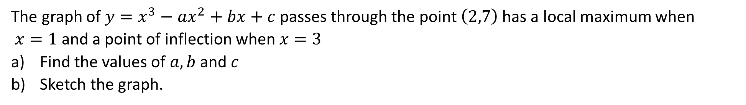





Guided Practice
The graph of $y=x^{3}−ax^{2}+bx+c$ passes through the point $\left(2,7\right)$ has a local maximum when
$x=1$ and a point of inflection when $x=3$
Find the values of $a, b$ and $c$
Sketch the graph.
$$\frac{dy}{dx}=3x^{2}−18x+15$$
$$\frac{d^{2}y}{dx^{2}}=6x−18$$
$$\frac{dy}{dx}=3x^{2}−2ax+b$$
Sub $\frac{dy}{dx}=0, 3x^{2}−18x+15=0$
$$\frac{d^{2}y}{dx^{2}}=6x−2a$$
$$3\left(x^{2}−6x+5\right)=0$$
Sub $\frac{d^{2}y}{dx^{2}}=0, x=3, 6\left(3\right)−2a=0$
$$(x−5)(x−1)=0$$
$$x=5,x=1$$
$$a=9$$
Sub $\frac{dy}{dx}=0, a=9, x=1, 3{(1)}^{2}−2\left(9\right)\left(1\right)+b=0$
Sub $x=5$ into $\frac{d^{2}y}{dx^{2}}$ $, f^{′′}\left(0\right)=12>0$
$$b=15$$
Sub $x=5$ into $y, y=−20$
Sub $y=7, a=9, b=15, x=2, {\left(2\right)}^{3}−9{\left(2\right)}^{2}+15\left(2\right)+c=7$
$∴(5,−20)$ is a local minimum turning point
$$c=5$$

Slide 22


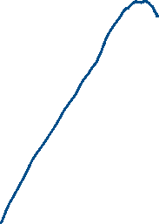







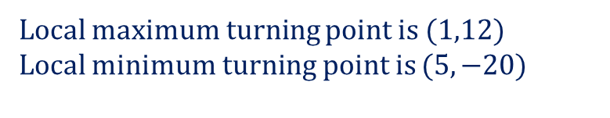


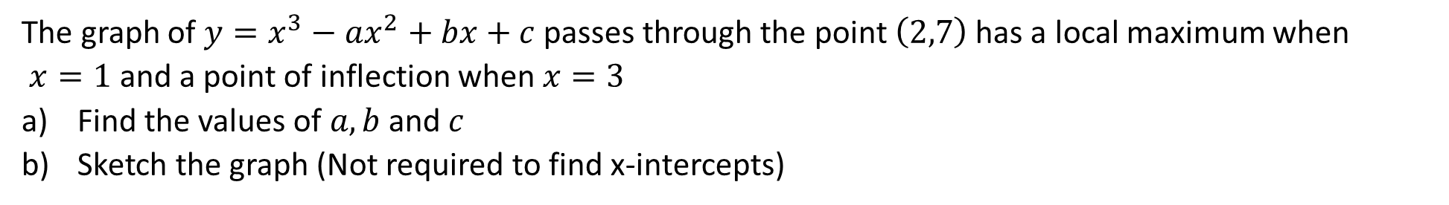
Guided Practice
The graph of $y=x^{3}−ax^{2}+bx+c$ passes through the point $\left(2,7\right)$ has a local maximum when
$x=1$ and a point of inflection when $x=3$
Find the values of $a, b$ and $c$
Sketch the graph (Not required to find x-intercepts)
$$y=x^{3}−9x^{2}+15x+5$$
Sub $x=1$ into $y, y=12$
Local maximum turning point is $(1,12)$
Local minimum turning point is $(5,−20)$
Sub $x=3$ into $y, y=−4$
Point of inflection is $(3,−4)$
$$\frac{d^{2}y}{dx^{2}}=6x−18$$
When $x<3,\frac{d^{2}y}{dx^{2}}<0$
When $x>3, \frac{d^{2}y}{dx^{2}}>0$
Sub $x=0$ into $y, y=5$
y$−intercept: (0,5)$

Slide 23
Independent Practice
Complete Cambridge Ex 5E exclude Q20, 21

